Slide 1
Object Oriented Analysis

Slide 2
Inception
Most project require a short initial step to common vision and basic scope of the project.
Where the following questions are explored:
What is the vision & business case for the project?
Feasible ?
Buy and/or build?
Rough range of cost?
Should we proceed or stop?

Slide 3
The purpose of inception phase is not to define all the requirements
Most requirement analysis occurs during elaboration phase
Thus inception is defined as
Envision the product scope , vision & business case
In short, inception establishes some initial common vision for objectives of the project, determine its feasibility & decide if it is worth some serious investigation in elaboration.

Slide 4
How much UML during inception
Since more focus in inception is on understanding the basic scope & 10% of requirements, expressed mostly in text terms
In practice, & thus in this presentation, most UML diagramming will occur in the next phase – elaboration.

Slide 5
Elaboration
Having introduced inception, next phase elaboration where requirements are identified & performed iterative & evolutionary refinement to them.

Slide 6
Requirements
The capabilities and conditions to which the system- and more broadly, the project must confirm.
It is the systematic approach to finding , documenting, organizing and tracking the changing requirement of the system iteratively & skillfully.
A prime challenge of requirements work is to find, communicate, and record what is really needed, in a form that clearly speaks to the client and development team members.
It includes both functional or non-functional requirements.

Slide 7
functional
calculations, technical details, data manipulation and processing and other specific functionality
non-functional ;
(also known as quality requirements), which impose constraints on the design or implementation(such as performance requirements, security, cost and reliability).

Slide 8
What are the skillful means to find requirements?
Unified process(UP) encourages skillful elicitation via technique such as writing use cases with customers.
Organizing requirement workshops that includes both developers & customers.
Focus groups with proxy customers &
A demo of the results of each iteration to the customers, to solicit feedback.
The UP welcomes any requirement elicitation method that can add value & increase user participation.

Slide 9
Requirement types & categories
In the UP, requirements are categorized according to FURPS+ model.
Functionality—features, capabilities, security.
Usability—human factors, help, documentation.
Reliability—frequency of failure, recoverability, predictability
Performance—response times, throughput, accuracy, availability, resource usage
Supportability—adaptability, maintainability, internationalization, configurability

Slide 10
The "+" in FURPS+ indicates ancillary and sub-factors, such as:
Implementation—resource limitations, languages and tools, hardware, ...
Operations—system management in its operational setting.
Packaging
Legal—licensing and so forth.

Slide 11
It is helpful to use FURP+ categories as checklist for requirement coverage &
To reduce risk of not considering some important facet of the system.

Slide 12
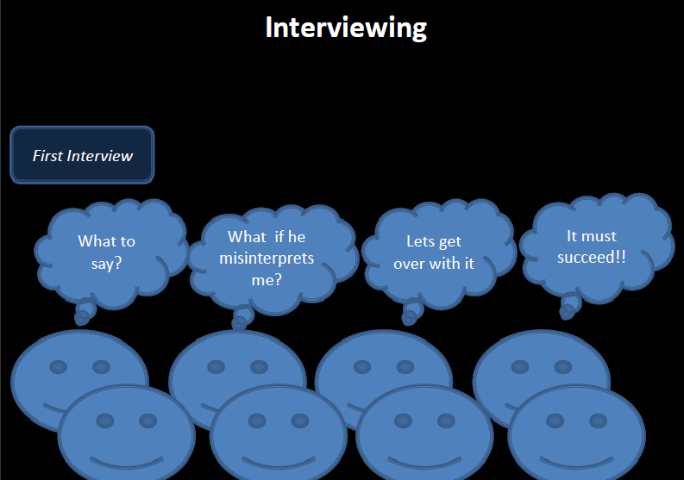
Interviewing

Slide 13
Interviewing contd…
The analyst starts by asking context-freequestions;
a set of questions that will lead to a basic understanding of the problem,
the people who want a solution, the nature of the solution desired, and the effectiveness of the first encounter itself.
Structured Questioning Techniques usually lead by software engineer :
why are we building this system?
who are the other users?
determine critical functionality?

Slide 14
Interviewing contd…
Ask both open & close ended questions
Open ended questions:
useful when not much is known yet
examples "describeX " tell me what you do
Close ended questions:
when enough about the system is known try to ask specific questions
example "how often should sales reports be generated?”
Try to proceed from open-ended to closed-ended questions!!

Slide 15
Interviewing contd…
Rephrase answers
make sure you understood the client's answer, check for errors, inconsistencies and ambiguities
Find out who else to interview
who else uses the system
who interacts with you
who will agree / disagree with you

Slide 16
Interviewing contd…
The Q&A session should be used for the first encounter only and then be replaced by a meeting format that combines elements of problem solving, negotiation, and specification.
Customers and software engineers often have an unconscious "us and them" mindset.
Rather than working as a team to identify and refine requirements, each constituency defines its own "territory"and communicates through a series of memos, formal position papers, documents, and question and answer sessions.

Slide 17
FAST
facilitated application specification techniques (FAST),
this approach encourages the creation of a joint team of customers and developers who work together to
identify the problem,
propose elements of the solution,
negotiate different approaches, and
specify a preliminary set of requirements.

Slide 18
Facilitated Application Specification Technique (FAST)
Idea overcome we/them attitude between developers and users
team-oriented approach
Guidelines
–participants must attend entire meeting
–all participants are equal
–preparation is as important as meeting

Slide 19
all pre-meeting documents are to be viewed as “proposed”
off-site meeting location is preferred
set an agenda and maintain it
don’t get mired in technical detail
Approaches to FAST
–Joint Application Design (IBM)
–The Method (Performance Resources)

Slide 20
JAD(Joint Application Development
Sit down with the client and design a paper UI that they can see what the application will look like and behave like.
Give the user a chance to work through common scenarios and see if the application will work for them.
Keep refining until the user feels the application is doing what they want it to do.
As you get functionality implemented, bring the user in and have them work through those scenarios and see if it still works.
If they want a change, have a solid estimate of how long the change will add to the schedule and how much it will cost.

Slide 21
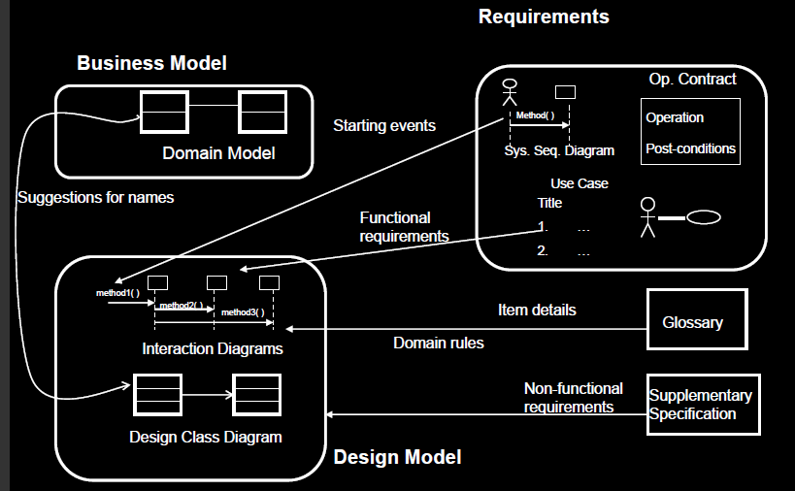
UP Artifacts

Slide 22
2. Object Oriented Analysis(OOA)
OOA —Decomposition of a domain into noteworthy concepts or objects.
A domain model is a visual representation of conceptual classes or real situation objects in a domain .
It is not of software objects such as Java or C# classes or software objects with responsibilities.
Domain model is also called conceptual model.

Slide 23
Fig: Domain Model
Sale
Sale
Date
time
dateTime
Print()
SalesDatabase

Slide 24
2.1 Building Conceptual model(Domain Model)

Slide 25
How to create a Domain Model?
Find conceptual classes
Draw them as classes in a UML class diagram
Add association & attributes

Slide 26
How to find conceptual classes?
Since domain model shows conceptual classes(represents an idea , thing or object), the prime question is how to find them?
There are three strategies to find conceptual classes
Reuse or modify the existing models – it is the first best & the easiest approach
There are published, well crafted domain models & data models which can be modified into domain models for many common domains, such as inventory, finance, health & so forth.

Slide 27
Use category list.
Identify noun phrases.
Reusing existing models is excellent, but outside our scope.
Method 2: The second method is using category list
One can start the creation of domain model by making a list of candidate conceptual classes.
Table below contains many common categories .

Slide 28
With an emphasis on business information system needs
The guideline also suggest some priorities in the analysis

Slide 29
Guideline: Find Conceptual Classes 1
Reuse or modify existing models
Use a category list.
Conceptual Class Category
Examples
business transactions
Guideline: These are critical (they involve money), so start with transactions.
Sale, Payment
Reservation
transaction line items
Guideline: Transactions often come with related line items, so consider these next.
SalesLineItem
product or service related to a transaction or transaction line item
Guideline: Transactions are for something (a product or service). Consider these next.
Item
Flight, Seat, Meal
where is the transaction recorded?
Guideline: Important.
Register, Ledger
FlightManifest

Slide 30
Guideline: Find Conceptual Classes contd..
Conceptual Class Category
Examples
place of transaction; place of service
Store
Airport, Plane, Seat
noteworthy events, often with a time or place we need to remember
Sale, Payment, Flight
physical objects
Guideline: This is especially relevant when creating device-control software, or simulations.
Item, Register Board, Piece, Die Airplane
descriptions of things
Guideline: See p. 147 for discussion.
Product Description
Flight Description
catalogs
Guideline: Descriptions are often in a catalog.
Product Catalog
Flight Catalog
containers of things (physical or information)
Store, Bin Board Airplane

Slide 31
Guideline: Find Conceptual Classes contd..
Conceptual Class Category
Examples
things in a container
Item Square (in a Board) Passenger
other collaborating systems
Credit Authorization System
Air Traffic Control
records of finance, work, contracts, legal matters
Receipt, Ledger
MaintenanceLog
financial instruments
Cash, Check, LineOfCredit
TicketCredit
schedules, manuals, documents that are regularly referred to in order to perform work
DailyPriceChangeList
RepairSchedule

Slide 32
Guideline: Find Conceptual Classes contd...
Conceptual Class Category
Examples
Physical or tangible object
POST, Airplane
Roles of people
Cashier, Pilot
Abstract noun concepts
Hunger, Acrophobia
Organizations
Sales Department
Events
Sale, Meeting, Flight
Process
SellingAProduct, Booking
Rules and policies
RefundPolicy

Slide 33
Method 3: Finding conceptual class with noun phrase:
Another useful technique( because of its simplicity) is linguistic analysis
Identify nouns or non noun phrases in textual description of domain&
Consider them as candidate conceptual classes or attributes.

Slide 34
Example:
Customer arrives at a POS check out with goods and/or services to purchase.
Cashier starts a new sale.
Cashier enters item identifier.
System records sale line item & presents item description, price & running total. Price is calculated from set of price rules. Cashier repeats steps 2-3 until indicates done.
System presents total with taxes calculated.

Slide 35
6. Cashier tells customer the total and ask for payment.
Customer pays & system handles payment.
System log the completed sale & sends the sale & payment information to the external accounting & inventory system.
System presents receipt.
Customer leaves with receipt & goods (if any)

Slide 36
Some of these noun phrase refer to
Candidate conceptual class
Conceptual class
Attributes
Weakness of this approach is the imprecision of natural language
Different noun phrase may represent the same conceptual class or attribute

Slide 37
All 3 strategies should be used initially :
even if that leads to much overlapping;
it should not take too long anyway;
best way to arrive at a rich set of conceptual classes;

Slide 38
What are conceptual classes?
Informally it is an idea, thing or object
More formally, a conceptual class may be considered in terms of its symbol, intension & extension.
Symbol – word or images representing a conceptual class.
Intension – Definition of a conceptual class.
Extension – the set of examples to which conceptual class applies

Slide 39
Example –Event of purchase transaction
May name it by the symbol Sale.
Intension of a Sale may state that it ” represents the event of the purchase transaction & has a date & time”
The extension of Sale is all the examples of to which class (sales) applies; in other words, the set of all sale instances in the universe.

Slide 42
Example: Find & draw conceptual classes
Case study: POS domain
From the category list & noun phrase analysis, list is generated of candidate conceptual classes for the domain
list is constraint to the requirements
In iteration 1 basic cash-only scenario of Process Sale.

Slide 43
Find Conceptual Classes: POS
A concept is an idea or notion that we apply to the things.
Intension: the definition of concept, e.g. the Customer may be a person or organization that purchases goods or services
Extension: the set of all objects to which the concept applies, e.g. the Customer may be “ John”, Tom”
<<tangible object>>
POSTerminal
<<thing in container>>
Item
<<place>>
Store
<<event or transactions>>
Sale
<<transaction line items>>
SalesLineItem
<<role of people>>
Cashier
<<roles of people>>
Customer
<<transaction>>
Payment
<<catalog>>
ProductCatalog
<<descritpions of things>>
ProductSpec

Slide 44
Find Conceptual Classes: POS 3
For iteration-1, the basic cash-only scenario of Process Sale.
Sale, Cashier, Cash, Payment,
Customer, Sales Line Item,
Store, Item, Product Description,
Register, Product Catalog, Ledger.

Slide 45
Find Conceptual Classes
Using these approaches we end up with candidate conceptual classes:
Some will be outside the current requirements (e.g. price rules);
Some will be redundant (e.g. goods is better described by item);
Some will be attributes of concepts rather than concepts themselves (e.g. price);

Slide 46
Guideline: Agile Modeling Maintain the Model in a Tool
It is normal to miss significant conceptual classes during early domain modeling & discover them during design sketching or programming.
To quickly understand & communicate agile is used.
Perfection is not the goal of Agile, and agile models are usually discarded shortly after creation.

Slide 47
Guideline: Report Objects Include 'Receipt' in the Model
Receipt is a noteworthy term in the POS domain.
But perhaps it's only a report of a sale and payment, and duplicate information.
Should it be there in the domain model?
Two factors to consider
Exclude it: Showing a report of other information in a domain model is not useful since all its information is derived or duplicated from other sources.
Include it: it has a special role in terms of the business rules: It confers the right to the bearer(paper) of the receipt to return bought items.

Slide 48
Guideline: Report Objects Include 'Receipt' in the Model
Since item returns are not being considered in this iteration, Receipt will be excluded.
During the iteration that tackles the Handle Returns use case, we would be justified to include it.

Slide 49
Guideline: Think Like a Mapmaker; Use Domain Terms
Make a domain model in the spirit of how a cartographer or mapmaker works:
Use the existing names in the territory. For example, if developing a model for a library, name the customer a "Borrower" the terms used by the library staff.
Exclude irrelevant or out-of-scope features.
Do not add things that are not there.

Slide 50
Guideline: How to Model the Unreal World
Some software systems for domains that find very little analogy in natural or business domains.
Example : software for telecommunication.
It requires a high degree of abstraction, and listening carefully to the core vocabulary and concepts that domain experts use.

Slide 51
Guideline: A Common Mistake with Attributes vs. Classes
Most common mistake when creating a domain model is to represent something as attribute when it should have been a conceptual class.
If we do not think of some conceptual class X as a number or text in the real world, X is probably a conceptual class, not an attribute.
In the real world, a store is not considered a number or text, the term suggests a legal entity, an organization, and something that occupies space. Therefore, Store should be a conceptual class.
Sale
Store
Sale
Store
phoneNumber

Slide 52
Guideline: When to Model with 'Description' Classes
A description class contains information that describes something else. For example, a ProductDescription that records the price, picture, and text description of an Item.
Problems: if implemented in software similar to the domain model, it has duplicate data (space-inefficient, and error-prone). Because the description, price, and itemID are duplicated for every Item instance of the same product
Item
description
price
serialNumber
itemID
productDescription
description
price
itemID
1 *
Item
serialNumber

Slide 53
Guideline: When to Model with 'Description' Classes
A particular Item may have a serial number; it represents a physical instance. A ProductDescription wouldn't have a serial number
Item
description
price
serialNumber
itemID
productDescription
description
price
itemID
1 *
Item
serialNumber

Slide 54
Example: Discovering Classes
Library Management System (LMS)
RESPONSIBILITIES
1. Borrow item
2. Reserve item
3. Return item
4. Remove reservation
5. Add borrower
6. Update or remove borrower
7. Add title (book or magazine)
8. Update or remove title
9. Add item
10. Update or remove item
11. Store loan details

Slide 55
Discovering Classes
Library Management System (LMS)
RESPONSIBILITIES
1. Borrow item
2. Reserve item
3. Return item
4. Remove reservation
5. Add borrower
6. Update or remove borrower
7. Add title (book or magazine)
8. Update or remove title
9. Add item
10. Update or remove item
11. Store loan details
COLLABORATIONS
Item
Reservation
Borrower
Title
Book Title
Magazine Title
Loan (Transaction)
Database

Slide 56
Initial class diagram

Slide 57
2.2 Adding attributes & associations

Slide 58
Association
Association
a relationship between classes (instances of those classes) that indicates some meaningful and interesting connection.
Records_current 1
Guideline: When to Show an Association?
Associations imply knowledge of a relationship that needs to be preserved for some duration.
Guideline: Avoid Adding Many Associations
Many lines on the diagram will obscure it with "visual noise."
Register
1
Sale

Slide 59
Association
Perspectives: Will the Associations Be Implemented In Software?
During domain modeling, an association is not data flows, database foreign key relationships, instance variables, or object connections in software solution.
it is meaningful in a purely conceptual perspective in the real domain.
Added to highlight our rough understanding of noteworthy relationships.

Slide 60
Association
We must discover all associations the application needs to preserve for some duration and discard all other associations in our domain model.
For example, we do need to remember what SalesLineItem instances are associated with a Sale.
On the other hand, while a Cashier may do a product look-up via a POS terminal, the system has no need to remember the fact that a Cashier has looked-up a particular ProductDescription: this is an important remark; associations are not there to record actions that actors may perform; they are there to support the information requirements of the processes that need to be implemented.

Slide 61
Association
We must only focus on the “need to remember” associations to avoid adding too many associations.
Eventually, the associations that we discover will likely end up being implemented as path of navigability between objects (using pointers to objects) : but we should not worry about this during OOA.

Slide 62
Associations
An association is represented as a line between classes with capitalized association name.
The ends of an association may contain a multiplicity expression indicating the numerical relationship between instances of the class. (e.g. 0..1)
An association is inherently bidirectional, meaning that from instances of either class, logical traversal to the other is possible.
An optional "reading direction arrow" indicates the direction to read the association name; it does not indicate direction of visibility or navigation (if absent, the default reading directions are from left to right or top to bottom).

Slide 63
Association
Guideline : How to name associations in UML?
Name an association based on a ClassName-VerbPhrase-ClassName format where the verb phrase creates a sequence that is readable and meaningful.
Association names should start with a capital letter, since an association represents a classifier of links between instances;
e.g. Sale Paid-by CashPayment: bad example (doesn't enhance meaning): Sale Uses CashPayment
e.g. Player Is-on Square: bad example (doesn't enhance meaning): Player Has Square
Two common & equally legal formats for compound association name are:
Records-current
RecordsCurrent

Slide 64
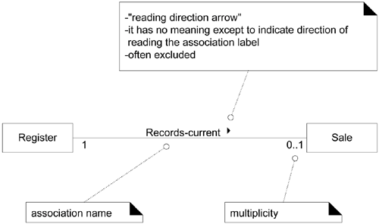
Associations

Slide 65
Associations
Each end of an association is called a role. Roles may optionally have:
multiplicity expression
name (to clarify meaning)
navigability (not relevant during OOA)

Slide 66
Associations
Multiplicity defines how many instances of a class A can be associated with one instance of a class B
The multiplicity value communicates how many instances can be validly associated with another, at a particular moment, rather than over a span of time.
For example, it is possible that a used car could be repeatedly sold back to used car dealers over time.
But at any particular moment, the Car is only Stocked-by one Dealer.
No Car can be Stocked-by many Dealers at any particular moment.

Slide 67
Association

Slide 68
Association
Applying UML: Multiple Associations Between Two Classes
Guideline: Find Associations with a Common Associations List
Category
Examples
A is a transaction related to another transaction B
CashPayment-Sale
Cancellation-Reservation
A is a line item of a transaction B
SalesLineItem-Sale
A is a product or service for a transaction (or line item) B
Item-SalesLineItem (or Sale), Flight-Reservation
A is a role related to a transaction B
Customer-Payment
Passenger-Ticket

Slide 69
Association
Category
Examples
A is a physical or logical part of B
Drawer-Register, Square-Board, Seat-Airplane
A is physically or logically contained in/on B
Register-Store, Item-Shelf, Square-Board, Passenger-Airplane
A is a description for B
ProductDescription-Item, FlightDescription-Flight
A is known/logged/recorded/ reported/captured in B
Sale-Register, Piece-Square, Reservation-FlightManifest
A is a member of B
Cashier-Store, Player-MonopolyGame, Pilot-Airline
A is an organizational subunit of B
Department-Store, Maintenance-Airline
A uses or manages or owns B
Cashier-Register, Player-Piece, Pilot-Airplane
A is next to B
SalesLineItem-SalesLineItem, Square-Square, City-City

Slide 70
Attributes
An attribute is a logical data value of an object.
Guideline: When to Show Attributes?
Include attributes that the requirements (e.g., use cases) suggest or imply a need to remember information.
e.g., a receipt (which reports the information of a sale) in the Process Sale use case normally includes a date and time, the store name and address, and the cashier ID,

Slide 71
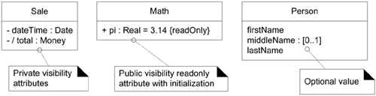
The full syntax for an attribute in the UML is:
visibility name : type multiplicity = default {property-string}
Examples:
{readOnly} is probably the most common property string for attributes. Private visibility (-) is usually implicit.
Attribute multiplicity can be used to indicate the optional presence of a value, or the number of objects that can fill a (collection) attribute.

Slide 72
Attributes
Guideline: Where to Record Attribute Requirements?
to use a tool that integrates UML models with a data dictionary; then all attributes will automatically show up as dictionary elements.
Derived Attributes
The total attribute in the Sale can be calculated or derived from the information in the SalesLineItems.

Slide 73
Attributes
Guideline: Focus on Data Type Attributes in the Domain Model.
most attribute types should be primitive data types, such as numbers and booleans.

Slide 74
Attributes
Guideline: Don't show complex concepts as attributes; use associations

